Slide 1
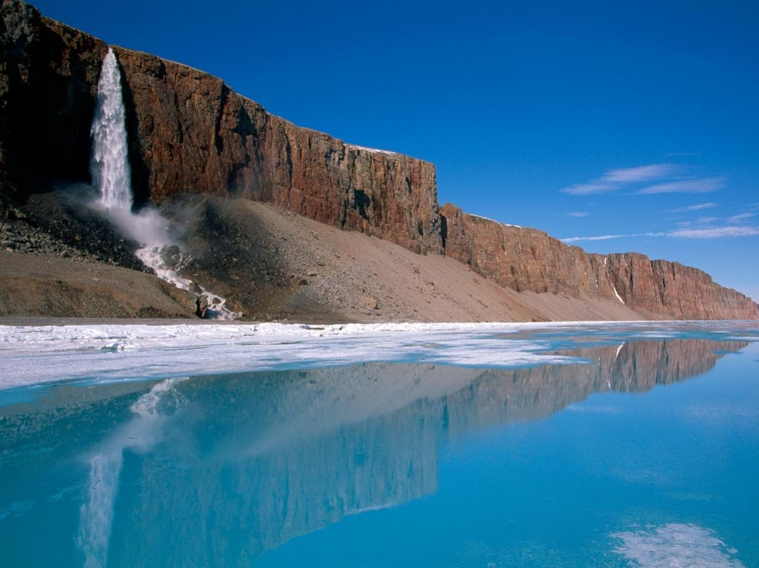
Weathering, Erosion and Deposition

Slide 2
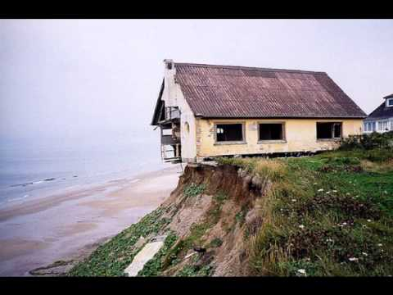
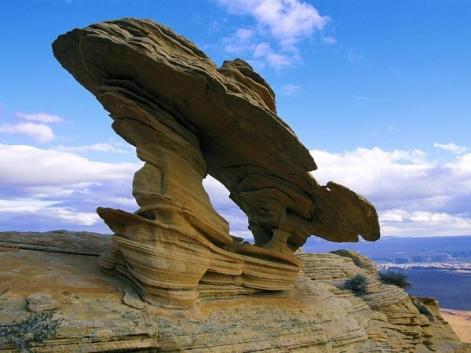
Weathering: the breaking down of rocks and minerals due to wind, water, ice, chemicals or plants and animals.
Weathering by the Wind
Particles of sand wear away the rocks
Waves and wind from the ocean wear down the coast

Slide 5
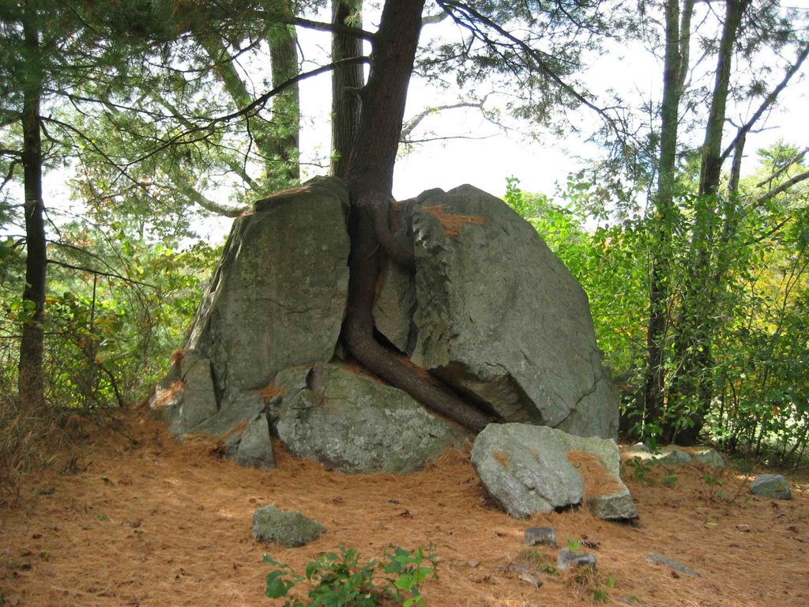
Plants can cause rocks to split as they grow

Slide 7
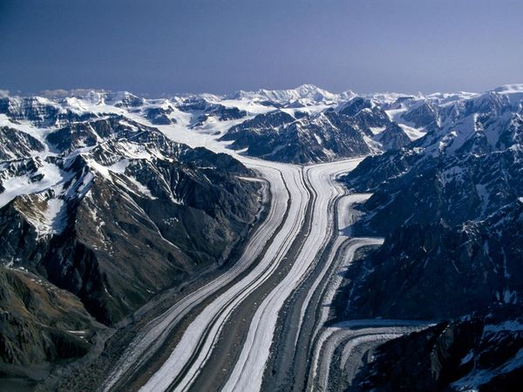
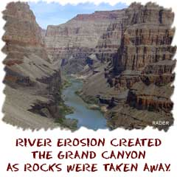
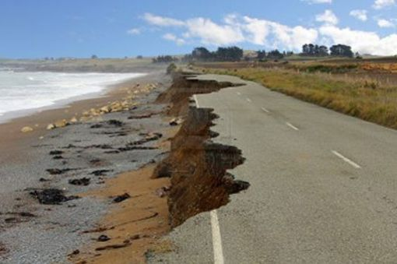

Slide 8
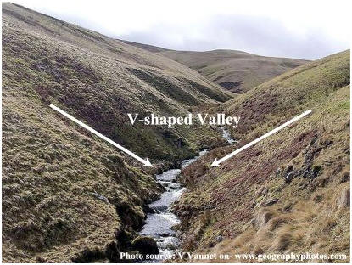
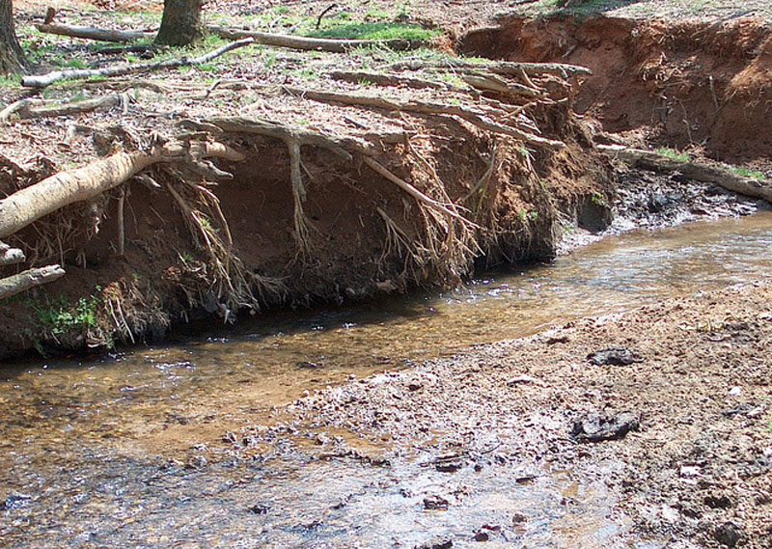
Erosion of river bank by moving water
Erosion of hills to
form a valley

Slide 10
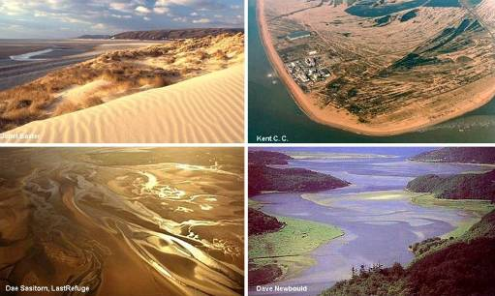
Deposition is when sediments and broken down substances are moved to another location by wind, glacier ice, or water moving.

Slide 11
